Slide 1

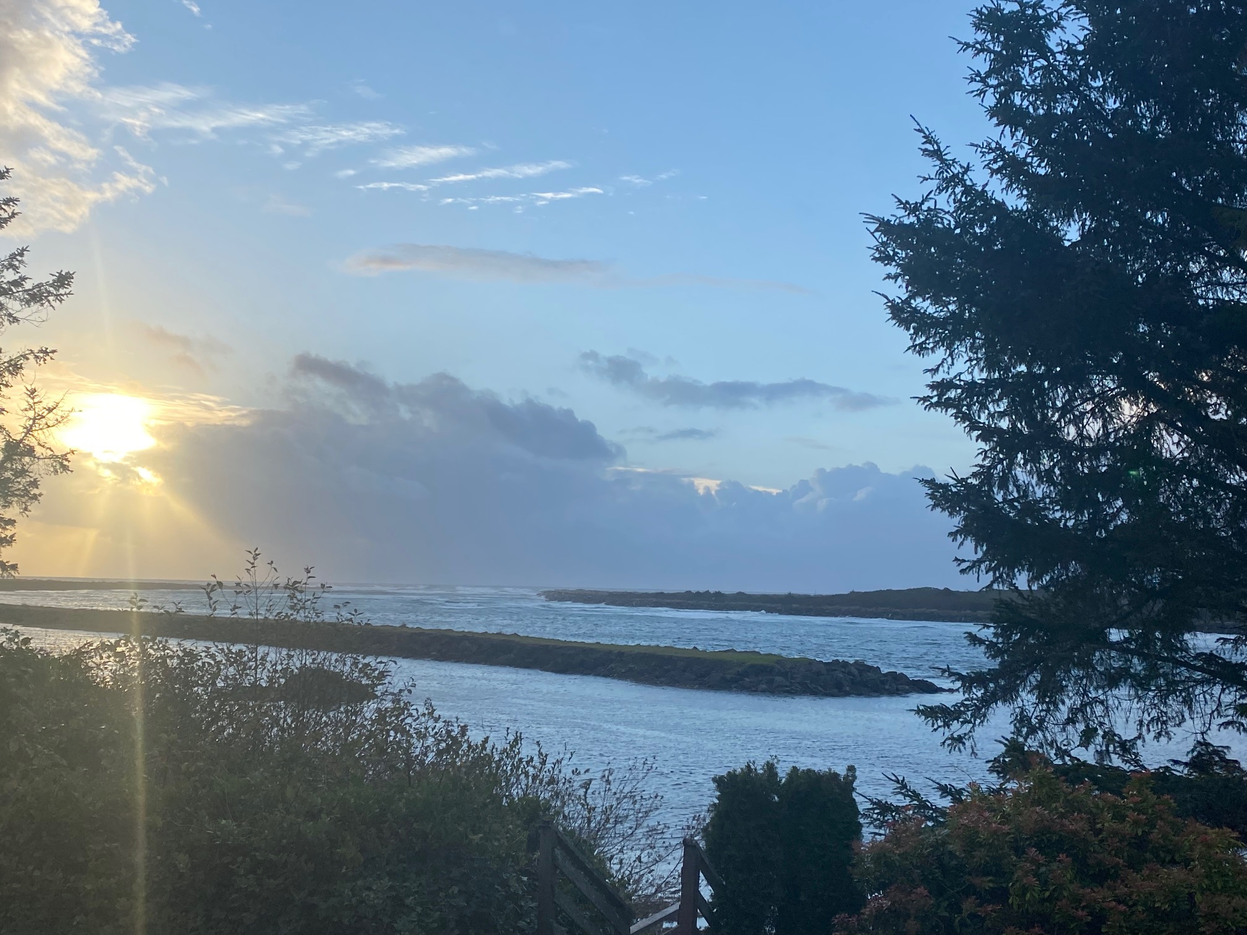






OPPORTUNITY: NSF MID-SCALE R1 INFRASTRUCTURE PROPOSAL (NSF 21-505)
Coastal Critical Zone Observatory
Currently no NSF Coastal Observatory in the US
>40% of Americans live in coastal shoreline counties
60% of Americans live w/in 2 h of the coast
Natural, managed, and socioeconomic coastal systems are subjected to complex interacting stresses
Propose a Process to Design a Coastal Observatory
Build upon prior workshops, position papers, and capabilities
Inclusion of other Networks, and Agency Programs
Continental in scale
Design to better Understand Changing Coastal Processes
Inclusion of a Social Dimension is Key
Design Workforce pipeline for under-served communities
Design a workforce pipeline for the observatory,
Prototype workforce pipeline in context of the proposal
Education and Training focused on DEI
Background
Clemson Belle Baruch Coastal Infrastructure Workshop
This effort builds upon a workshop held in 2019, in which a draft conceptual framework for a Coastal Observatory was developed. Broad attendance that included NSF, NOAA NEERS, DHS, Coastal Guard, Sea Grant, USGCRP IWG, and a broad range of scientific expertise.
Experienced Team to Scope Infrastructure
The Core Science Team (> 40 Participants) and Formal Project Management (PMP) team (>10 Participants) have been meeting regularly for [time]. We expect these teams to grow and include new partnerships. Experience in scoping infrastructure within NSF (NEON, CMO, others) and Globally (GERI). This Team has working relationship with the NSF Large Facility Office, and the G7 Group of Senior Advisors for Research Infrastructure (GSO). We employ a State-of-the-Art System Engineering Approach that is based on a dynamic model framework.
Aligned with the recommendations in National Academy Reports
NSF-supported: Next Generation of Earth Systems Science (2021)
NSF-supported: Catalyzing Opportunities for Research in the Earth Sciences (CORES): Decadal Survey (2020)
Others
Contact:
Skip Van Bloem, Clemson U, skipvb@clemson.edu
Nirav Merchant, U Arizona, nirav@email.arizona.edu
Will Ambrose, Coastal Carolina U, wambrose@coastal.edu
Hank Loescher, Battelle, hloescher@battelleecology.org

Slide 2
OPPORTUNITY: NSF MID-SCALE INFRASTRUCTURE PROPOSAL (NSF 21-505)
Talking Points: Draft Proposal Scope
Two types of NSF Mid-Scale Proposal categories:
R1 = Design (up to $20M)
R2 = Full Implementation (up to $100M)
We advocate for an R1 Design Proposal
Period of Performance = up to 3 years
To include Physical, Information, and Support Infrastructure, and Workforce Pipeline for underserved groups.
Many Competing Coastal Research Interests
Research and Agency Programs
Observatory design primarily focused on place-based approaches is no longer novel
Previous attempts for a coastal observatory failed because of this.
Inclusion Strategy for Coastal Research Flipping the script through CI integration Demonstrate value added to other networks
Placed based observations to fill knowledge gaps
Defined Coastal Critical Zone
The place where land, water and people meet.
Includes river deltas, and estuarine areas
Co-Development of Knowledge
Coastal biogeochemical processes
Saltwater intrusion, sea-level rise,
[other text]
Social Dimension Integration: Portfolio Theory
Ecosystem Services
Local to Regional Economies
Jurisprudence, Equity and Policy
Needs Assessment: Educational and Engagement for underserved communities
Novel curriculum and learning materials.
Removal of technical barriers
Co-Design a Workforce Development Pipeline
[other text]
Next Steps and Paths Forward
Collaborative Participation of the Coastal Research Community
Bring together key members of the Coastal Research Community
Outline the proposal approach
Listen, respect, and work to accommodate proposal ideas, concerns, questions
Co-develop the proposal that reflects the insights, knowledge, and experience of all participants
Plan follow-up workshops that engage broader interests and begin scoping the proposal
Identify others or other skillsets that will be needed for success
Develop a trusted means of communication and regular updates
** Submission Date is February 2023 **
Contact:
Skip Van Bloem, Clemson U, skipvb@clemson.edu
Nirav Merchant, U Arizona, nirav@email.arizona.edu
Will Ambrose, Coastal Carolina U, wambrose@coastal.edu
Hank Loescher, Battelle, hloescher@battelleecology.org

Slide 3
OPPORTUNITY: NSF MID-SCALE INFRASTRUCTURE PROPOSAL (NSF 21-505)
Talking Points: Draft Proposal Scope
Two types of NSF Mid-Scale Proposal categories:
R1 = Design (up to $20M)
R2 = Full Implementation (up to $100M)
We advocate for an R1 Design Proposal
Period of Performance = up to 3 years
To include Physical, Information, and Support Infrastructure, and Workforce Pipeline for underserved groups.
Many Competing Coastal Research Interests
Research and Agency Programs
Observatory design primarily focused on place-based approaches is no longer novel
Previous attempts for a coastal observatory failed because of this.
Inclusion Strategy for Coastal Research
Flipping the script through CI integration Demonstrate value added to other networks
Placed based observations to fill knowledge gaps
Defined Coastal Critical Zone
The place where land, water and people meet.
Includes river deltas, and estuarine areas
Co-Development of Knowledge
Coastal biogeochemical processes
Saltwater intrusion, sea-level rise,
[other text]
Social Dimension Integration: Portfolio Theory
Ecosystem Services
Local to Regional Economies
Jurisprudence, Equity and Policy
Needs Assessment: Educational and Engagement for underserved communities
Novel curriculum and learning materials.
Removal of technical barriers
Co-Design a Workforce Development Pipeline
[other text]
[Draft] Coastal Grand Challenge Questions
GC1: Uncertainties in Coastal Ecosystem Processes: How will coastal ecosystems [of the United States] and their components respond to changes in natural- and human-induced drivers such as climate, sea level rise, saltwater intrusion, extreme events, and intensifying storms and inland flooding, across a range of spatial and temporal scales? And, what is the pace and pattern of these responses? [cast into the cause-and-effect paradigm; cast into a scaling strategy]
GC2: Internal Feedbacks in Coastal Processes: How do the internal responses and feedbacks of coastal processes such as, biogeochemistry, ecohydrology, and structure and function interact with changes in climate, sea-level rise, salt water intrusion, magnitude and periodicity of extreme events? How do coastal biogeochemical cycles evolve? And, how do these feedbacks vary with ecological context and spatial and temporal scales? [cast into feedback mechanisms]
GC3: Coastal Vulnerability: How stable, resilient, and resistant are coastal ecosystem processes with changing natural and anthropogenic drivers? How do we estimate tipping points that would transform a coastal ecosystem to a different state? Which coastal processes are particularly vulnerable to rapid and/or sustained changes?, and how do they scale? [cast into Chapin et al. 2009 resiliency framework]
GC4: Social Dimension: How do changes in coastal ecosystem processes affect Coastal Economies? How do the internal coastal ecosystem responses and feedbacks affect Coastal Economies? How do they scale from local to region? [linking ecosystem processes and vulnerability with coastal economies]
GC5: Challenging Theory and Model Predictability: How does theory and observations inform our understanding of coastal socio-ecological systems? And how can this enhanced understanding be challenged and improved by a modelled predictive capability? How do these models inform new observations or other required data for improved understandings of the coastal critical zone? [cast into a spiral improvement by challenging theory-observation-model-prediction paradigm]
Contact:
Skip Van Bloem, Clemson U, skipvb@clemson.edu
Nirav Merchant, U Arizona, nirav@email.arizona.edu
Will Ambrose, Coastal Carolina U, wambrose@coastal.edu
Hank Loescher, Battelle, hloescher@battelleecology.org

